Slide 1

PLOTLY EXPRESS + DASH INTRO
Presenter: ANITA TRAN

Slide 2

Who am I?
Anita Tran
Bachelor of Applied Science
2+ years of management consulting
Data Science

Slide 3
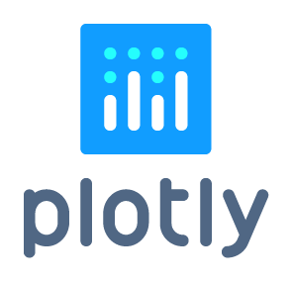

Matplotlib vs. Plotly
Standard in plotting graphs with Python
Integrates easily with Python Data Tools
Allows for complete custom design
Less complexity to animations
Same, but with fewer lines of code
Can handle complex animations

Slide 4
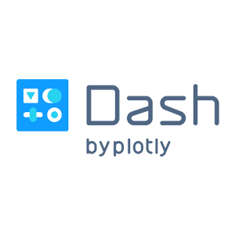
Plotly Express
Dash
Library for data visualization with focus on data exploration through rapid iteration
https://plotly.express
pip install plotly_express
Framework for creating analytical web applications in Python: no Javascript required
https://dash.plot.ly
pip install dash
Both are MIT Licensed: totally free for any purpose

Slide 5
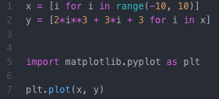
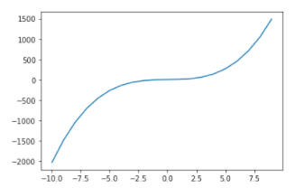
Let’s graph a cubic function with Matplotlib

Slide 6

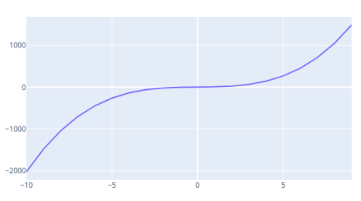
Plotly has great aesthetics

Slide 7
Plotly is interactive by default
Shown on-hover
Save as PNG
Zoom in and out
Data comparison

Slide 8
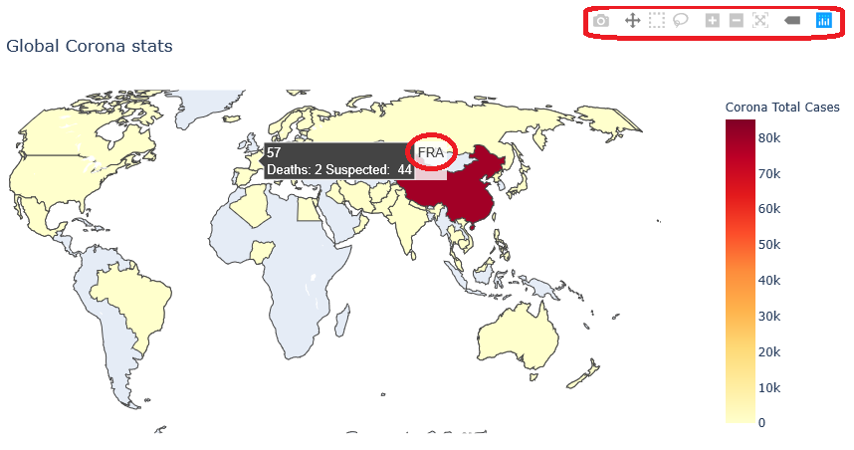
Other capabilities of Plotly Express
2D, 3D, polar ternary, maps , animations, faceting, trendlines, marginals
Export to various formats: PNG, SVG, HTML, PDF
GUI Editor for figure JSON in Jupyter Lab
Built-in and user defined themes

Slide 9
Complex dash app examples
Source: https://dash-gallery.plotly.host/dash-opioid-epidemic/

